Slide 1
Week 11
Triggers

Slide 2
Definition
A trigger is a special type of stored procedure that automatically executes when an event occurs in the database server.
DML
DDL
logon

Slide 3
DML Triggers
DML triggers execute when a user tries to modify data through a data manipulation language (DML) event.
DML events are INSERT, UPDATE, or DELETE statements on a table or view.

Slide 4
DDL Triggers
DDL triggers execute in response to a variety of data definition language (DDL) events.
These events primarily correspond to Transact-SQL CREATE, ALTER, and DROP statements, and certain system stored procedures that perform DDL-like operations.

Slide 5
Logon Triggers
Logon triggers fire in response to the LOGON event that is raised when a user's session is being established.

Slide 6
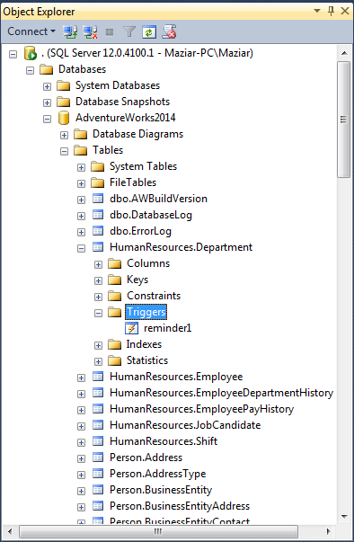
Example 1
USE AdventureWorks2014
Go
CREATE TRIGGER reminder1
ON HumanResources.Department
AFTER INSERT, UPDATE
AS
Print ('Insert or Update detected...');
GO
INSERT INTO HumanResources.Department
VALUES
('New Department', 'Quality Assurance',GETDATE());

Slide 7
Alter Trigger
ALTER TRIGGER HumanResources.reminder1
ON HumanResources.Department
AFTER INSERT, UPDATE
AS Print ('We are changing the Text message');
Using AFTER is very important

Slide 8
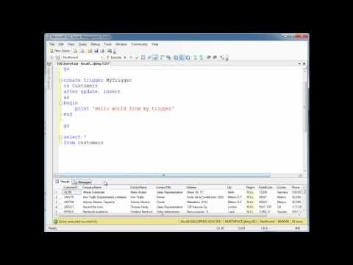
Watch the video
5 Minutes and 8 seconds

Slide 9
Using a server-scoped DDL trigger
GO
CREATE TRIGGER ddl_trig_database
ON ALL SERVER
FOR CREATE_DATABASE
AS
PRINT 'Database Created.'
Try the queries one by one
create database test11
Go
DROP TRIGGER ddl_trig_database
ON ALL SERVER;
GO
GO
Drop database test11

Slide 10
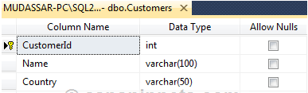
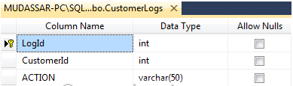
Trigger Example – In Class Lab
The following Trigger is fetching the CustomerId of the inserted record and the fetched value is inserted in the CustomerLogs table.
CREATE TRIGGER [dbo].[Customer_INSERT]
ON [dbo].[Customers]
AFTER INSERT
AS
BEGIN
SET NOCOUNT ON; -- for higher performance
DECLARE @CustomerId INT
SELECT @CustomerId = INSERTED.CustomerId
FROM INSERTED
INSERT INTO CustomerLogs
VALUES(@CustomerId, 'Inserted')
END
Think about the tables’ design.
Create a new ‘Week 12 Lab’ Database.
Create the tables and make the insert trigger.

Slide 11
In-Class Lab – Part II
The following Trigger is fetching the CustomerId of the deleted record and the fetched value is inserted in the CustomerLogs table.
CREATE TRIGGER [dbo].[Customer_DELETE]
ON [dbo].[Customers]
AFTER DELETE
AS
BEGIN
SET NOCOUNT ON;
DECLARE @CustomerId INT
SELECT @CustomerId = DELETED.CustomerId
FROM DELETED
INSERT INTO CustomerLogs
VALUES(@CustomerId, 'Deleted')
END
Create the delete trigger.

Slide 12
In-Class Lab – Part 3
Insert 8 Rows in the ‘customers’ table.
Then delete 3 rows.
The ‘customerslog’ table must have 11 rows.
Create a view to show all data in both tables.
Show data in the view table.

